Slide 1
Botnet Sniffer
A utility to identify DDOS attacks

Slide 2
Objective
Business requirements
Technical requirements
Design architecture
Limitations/Constraints

Slide 3
Objective
Identifying a DDOS attack by building a real time system that detects botnets and writes corresponding IP addresses into a file.

Slide 4
Business requirements
Read a file and write into Kafka
Application that reads messages from Kafka and identifies DDOS attack.
Application logs attackers ip address to a results directory.
Detect an attack every two minutes.*

Slide 5
Technical Requirements
Ingestion
Create a topic on kafka server.
A producer script written in python that reads logfile and write logentries into Kafka topic
Detection
A consumer script written in scala that reads logentries from topic, applies transformations.
Script runs every 2 seconds on rolling window with window size two minutes and sliding interval 10 seconds to get identify the threshold IP count.
This script will store threshold Ips (blacklisted IPS) address into a logfile stored in a predetermined location.

Slide 6
Technical requirements
Software Tools
Linux O/S
Kafka 2.11
Python 3.0
Pip 3
Jdk 1.8
Spark 2.4.4
Scala 2.11.2

Slide 7
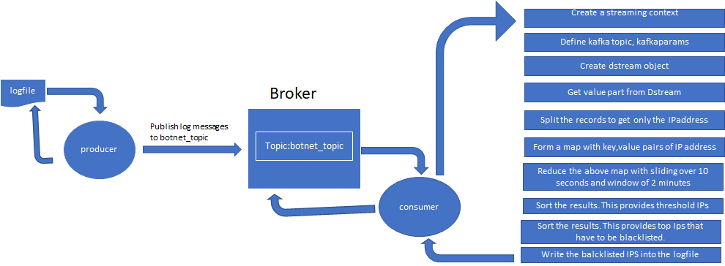
Design Architecture

Slide 8
Limitations and constraints
A real time production system is resilient, fault tolerant,failover mechnasim that cannot be achieved with a single host. Cluster environment is recommended.
A complete botnet algorithm will consider all scenarios that can cause a DDOS attack. However this program identifies bots based on the threshold Ipcount on a specified window size.

Slide 9
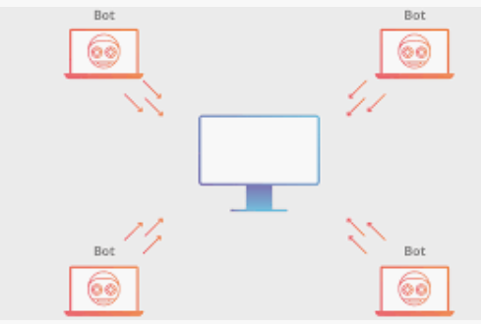
Thank you

